Slide 1


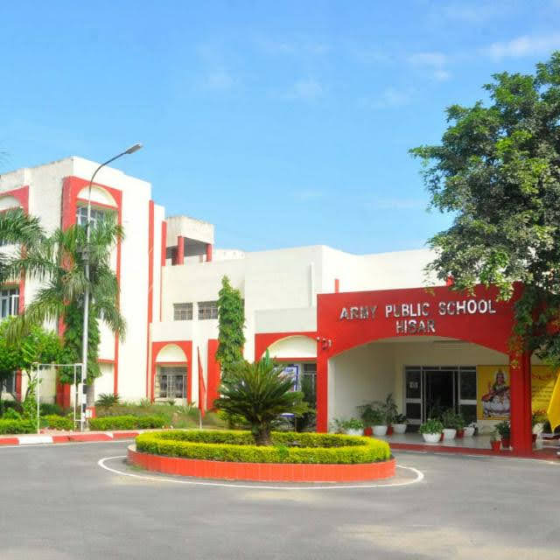

ARMY PUBLIC SCHOOL
HISAR
CELEBRATED
INTERNATIONAL DAY OF PERSONS WITH DISABILITIES
IN COLLABORATION WITH
ASHA SCHOOL HISAR

Slide 2

IDPWD DAY 2025
Army Public School Hisar and Asha School Hisar jointly celebrated the International Day of Persons with Disabilities on 3 December 2025 at the DOT Auditorium, Military Station Hisar. The event began with the lighting of the lamp by Mrs. Manvi Singh, Deputy Chairperson, FWO, 88 Armd Brigade. Students from both schools presented impressive cultural performances, while APS CWSN students and NSS volunteers staged a meaningful play on “Inclusive Education”, highlighting the message that every child is unique and deserves recognition for their abilities. Parents were delighted to witness the confidence and talent displayed by the Divyang students. All participants were honoured with gifts, and the Chief Guest delivered an inspiring speech on the importance of acknowledging the abilities of CWSN. The programme concluded with tea and refreshments. The event stood as a shining example of “collaboration and inclusion” between APS Hisar and Asha School and was appreciated by all.

Slide 3
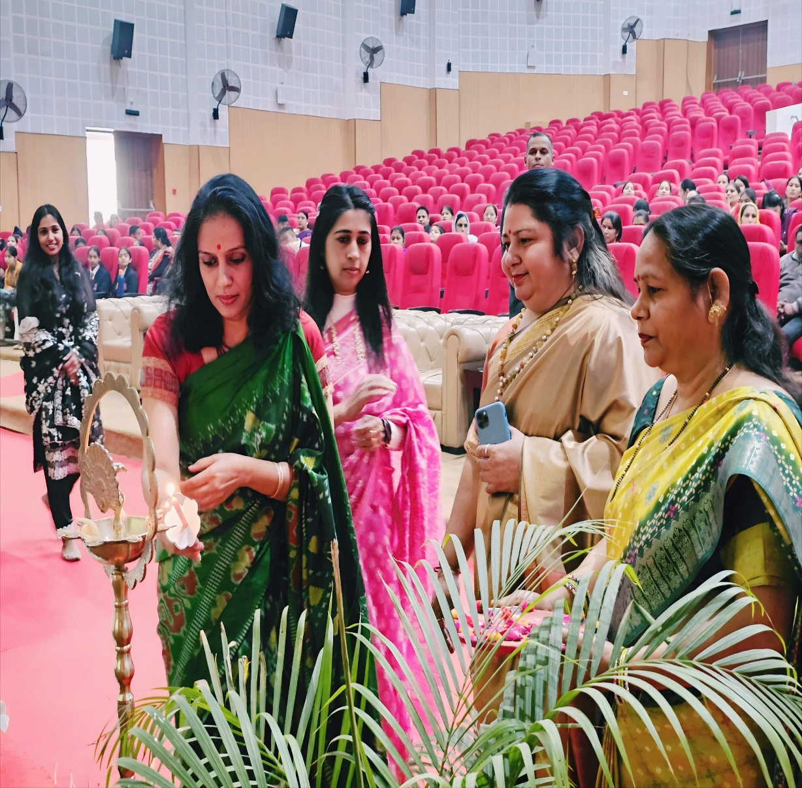
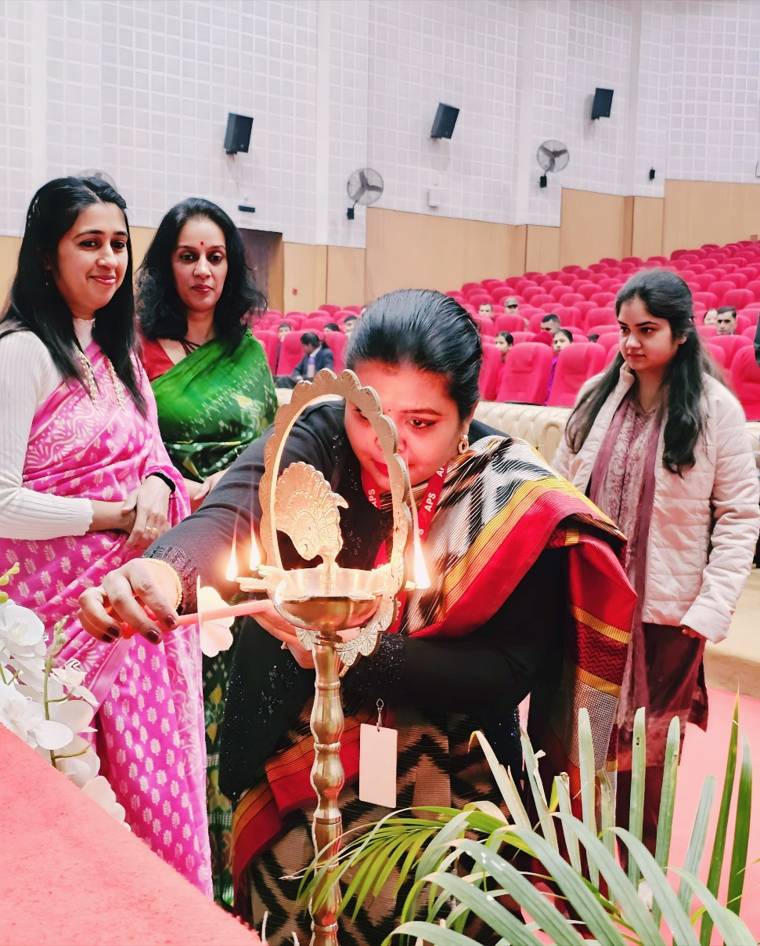
LIGHTING OF LAMP
The event began with the lighting of the lamp by Mrs. Manvi Singh, Deputy Chairperson, FWO, 88 Armd Brigade.

Slide 4
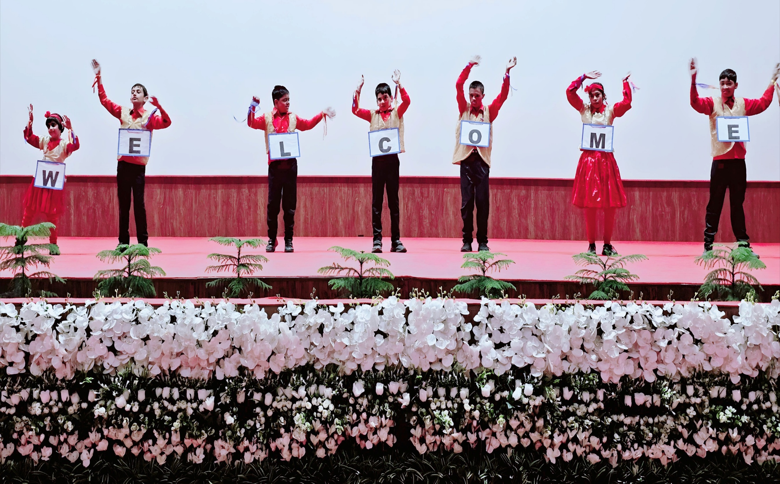
WELCOME SONG BY ASHA SCHOOL STUDENTS

Slide 5
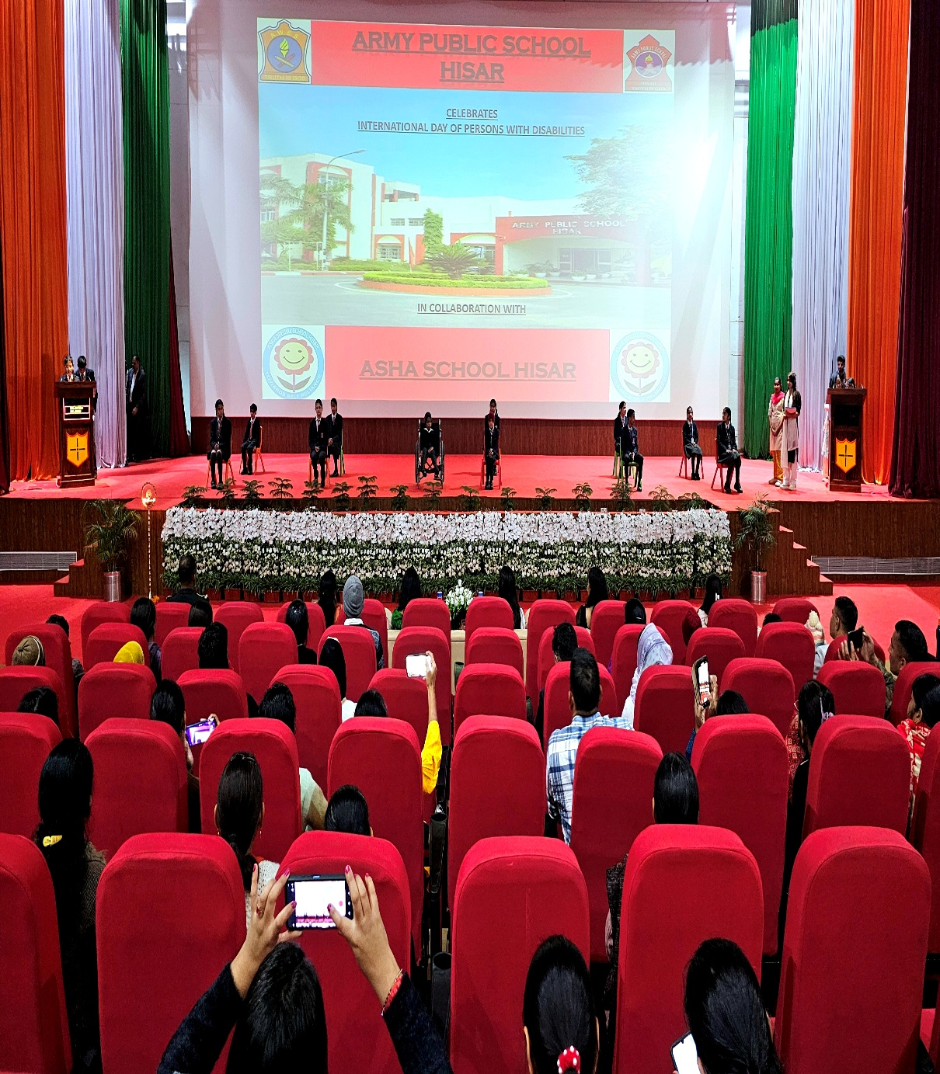
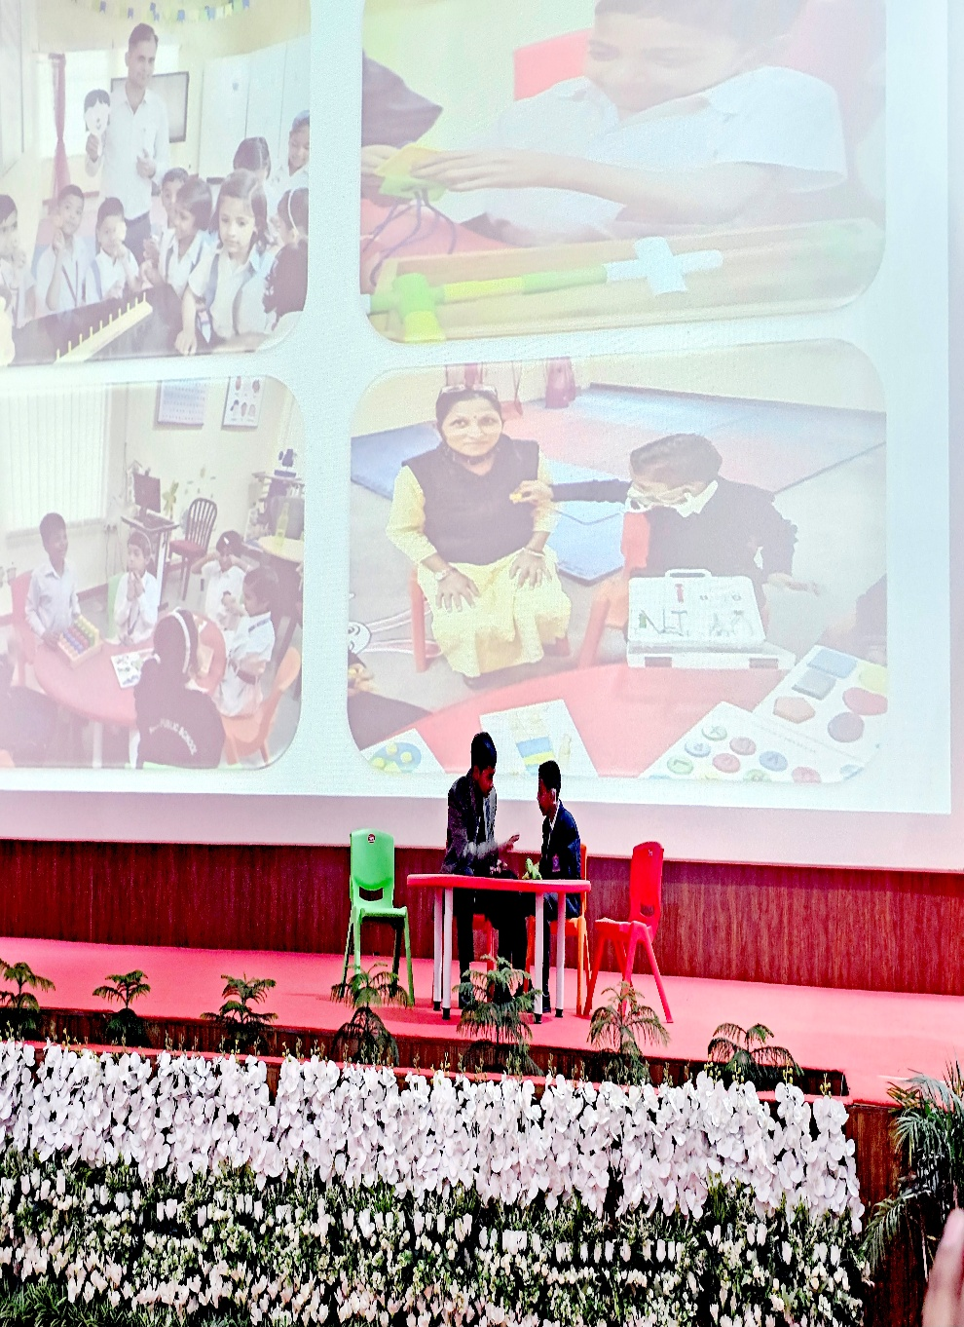
SKIT ON INCLUSIVE EDUCATION BY APS STUDENTS

Slide 6
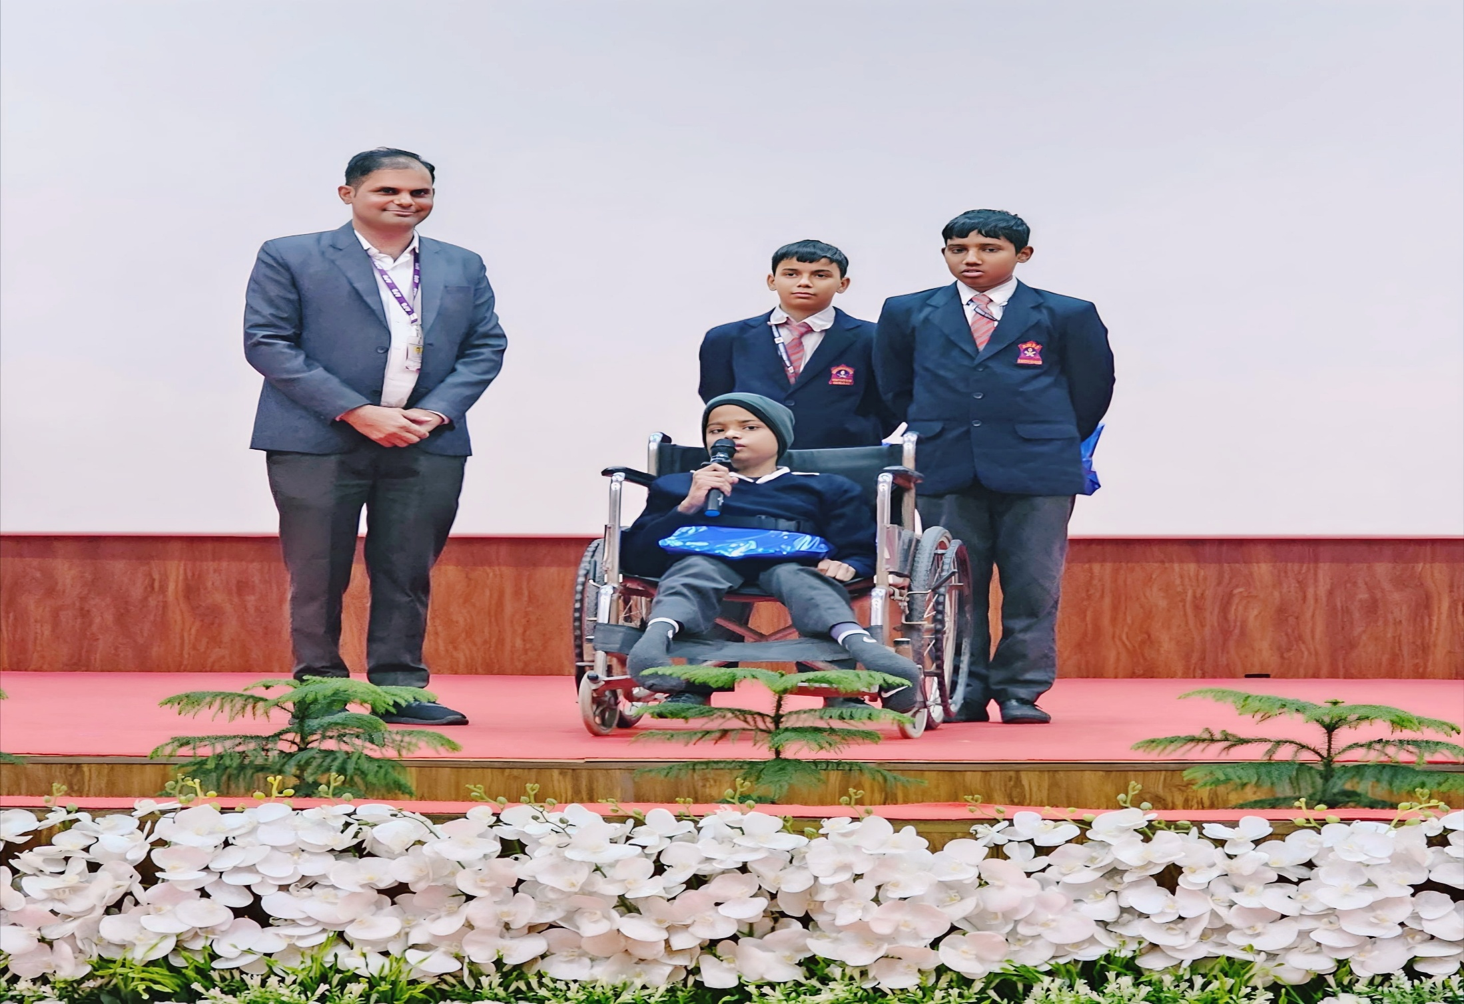
A SONG PERFORMED BY MASTER SHREYANSH OF APS STUDENT

Slide 7
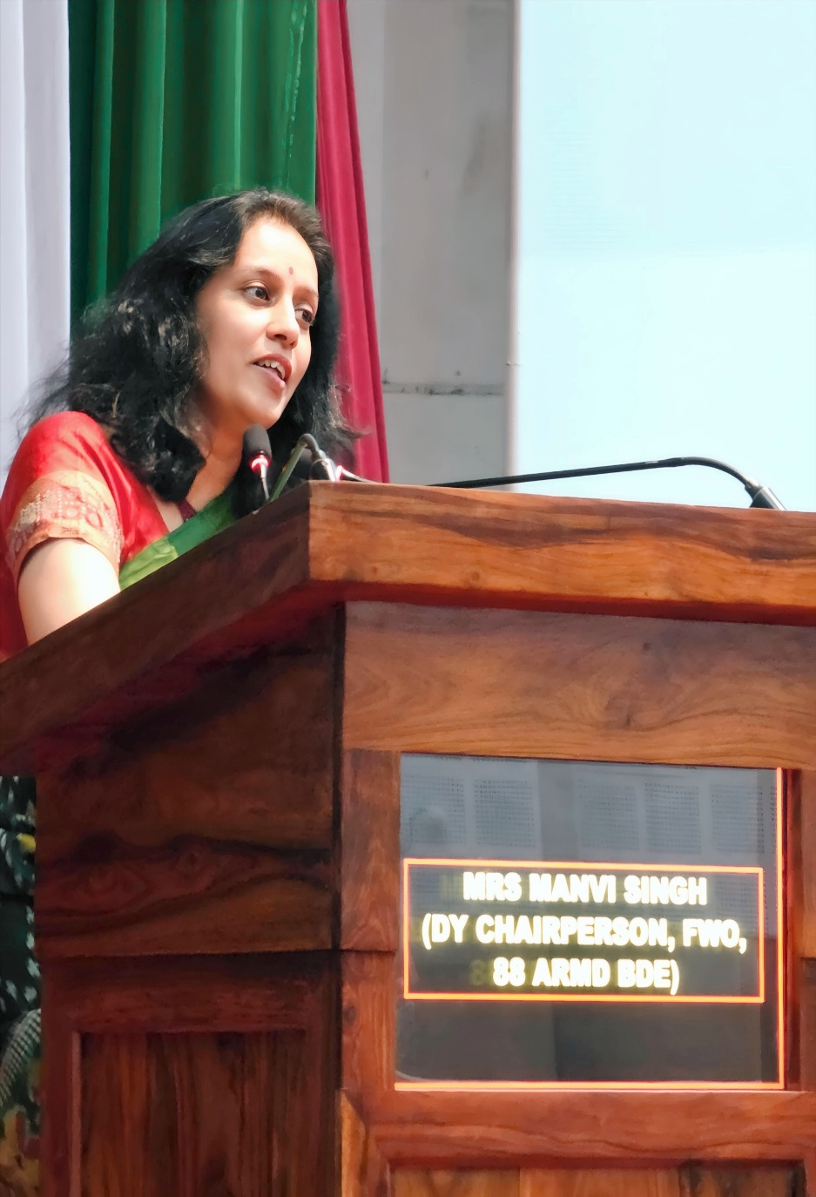
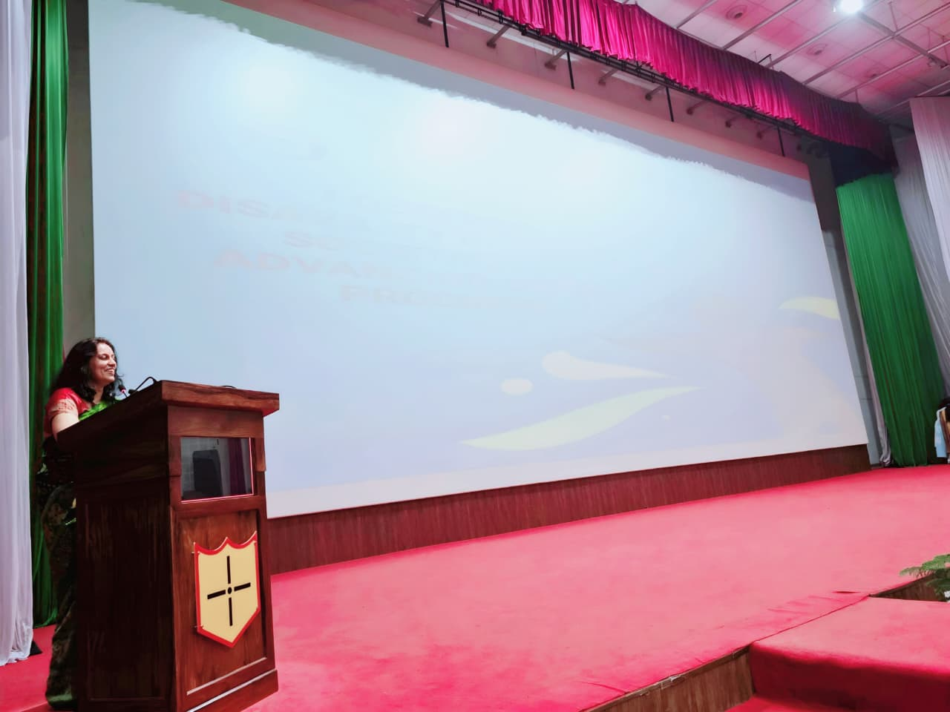
INSPIRATIONAL SPEECH BY CHIEF GUEST

Slide 8
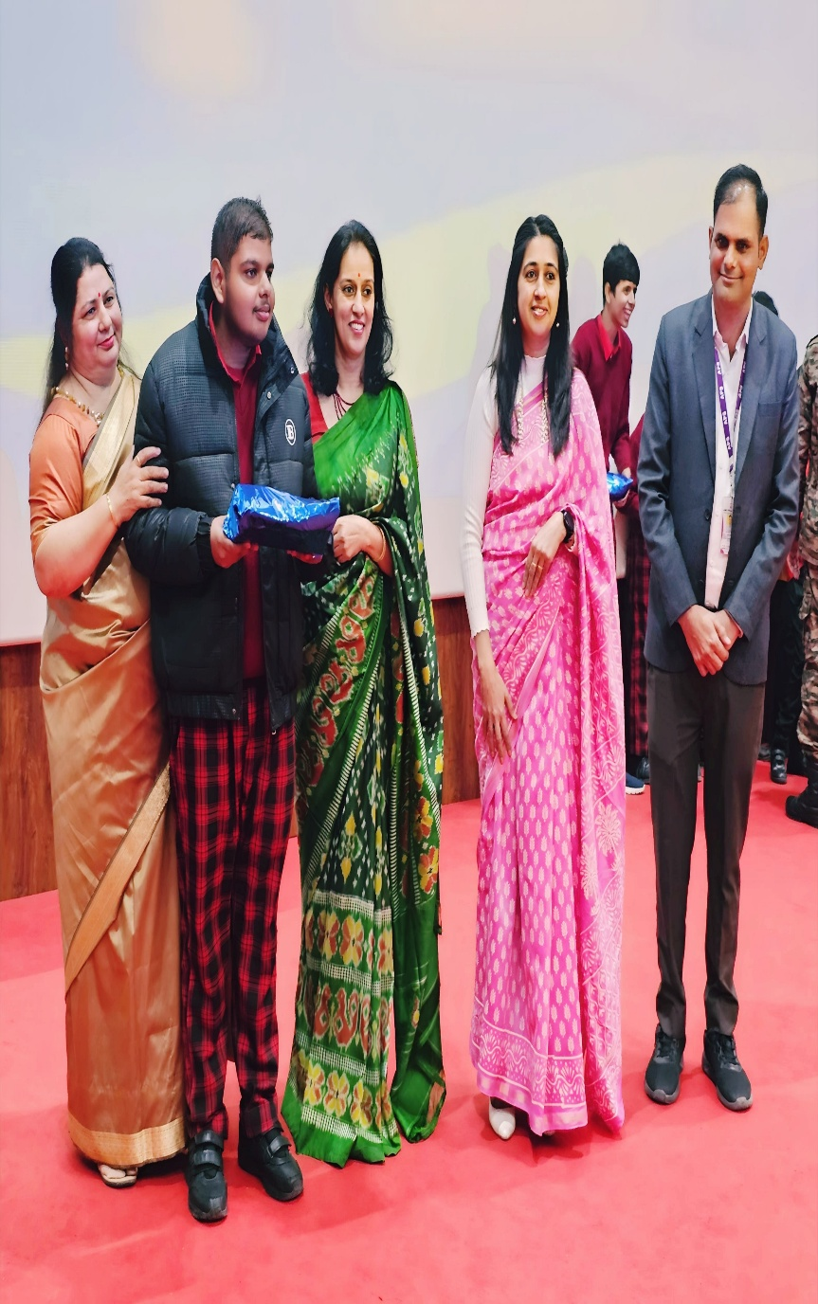
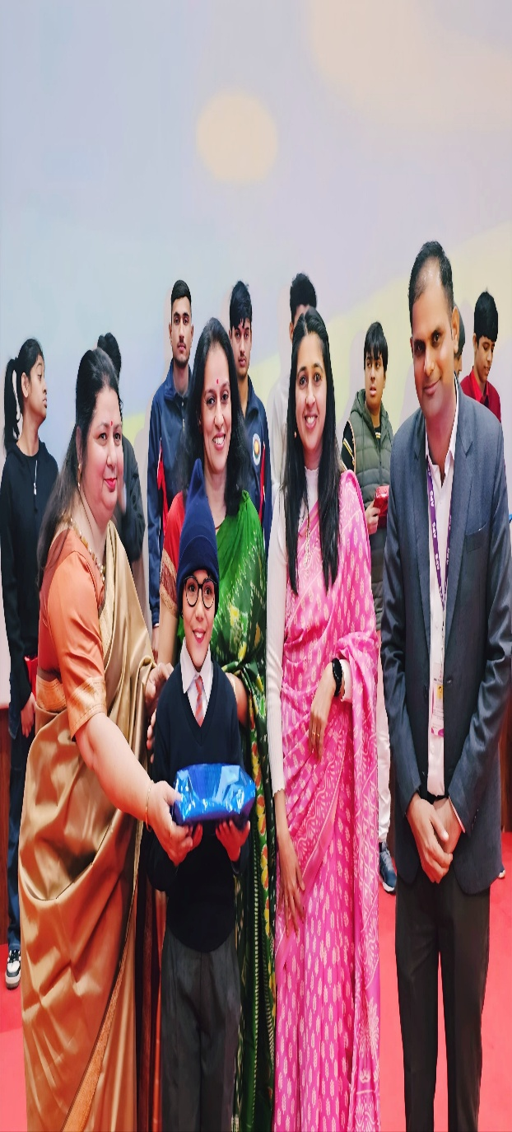
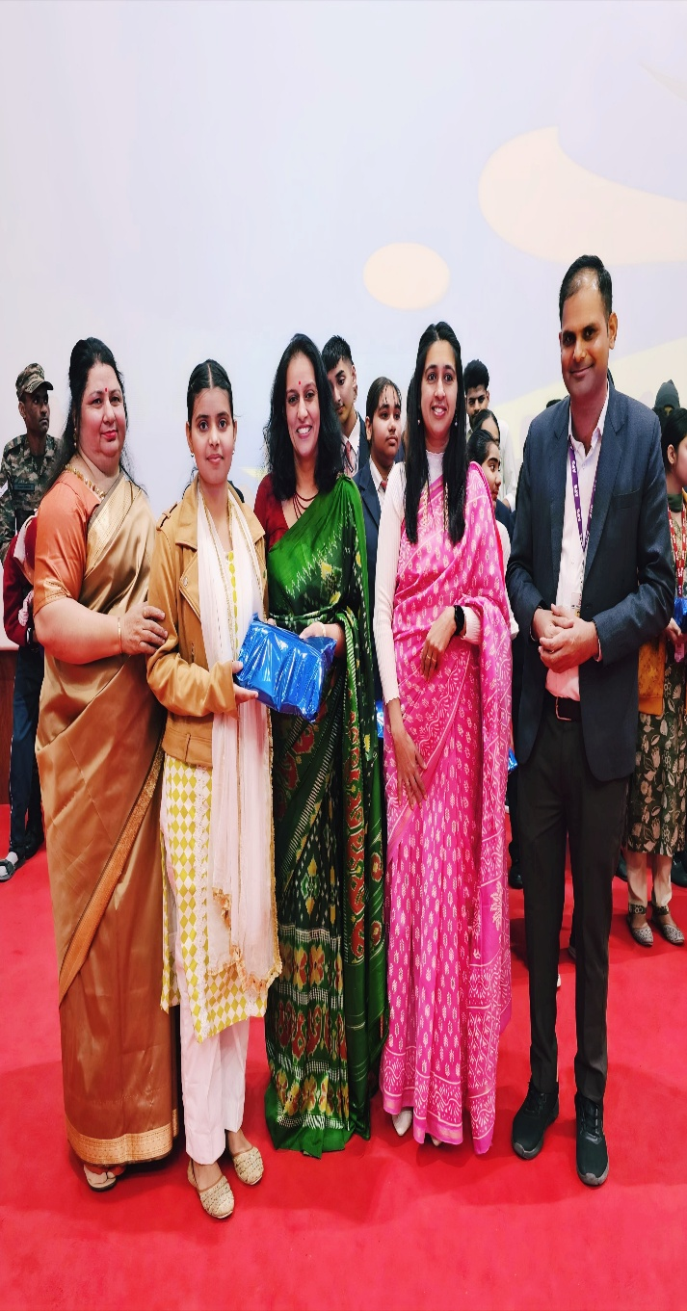
GIFTS/ TOKEN OF APPRECIATION DISTRIBUTION

Slide 9
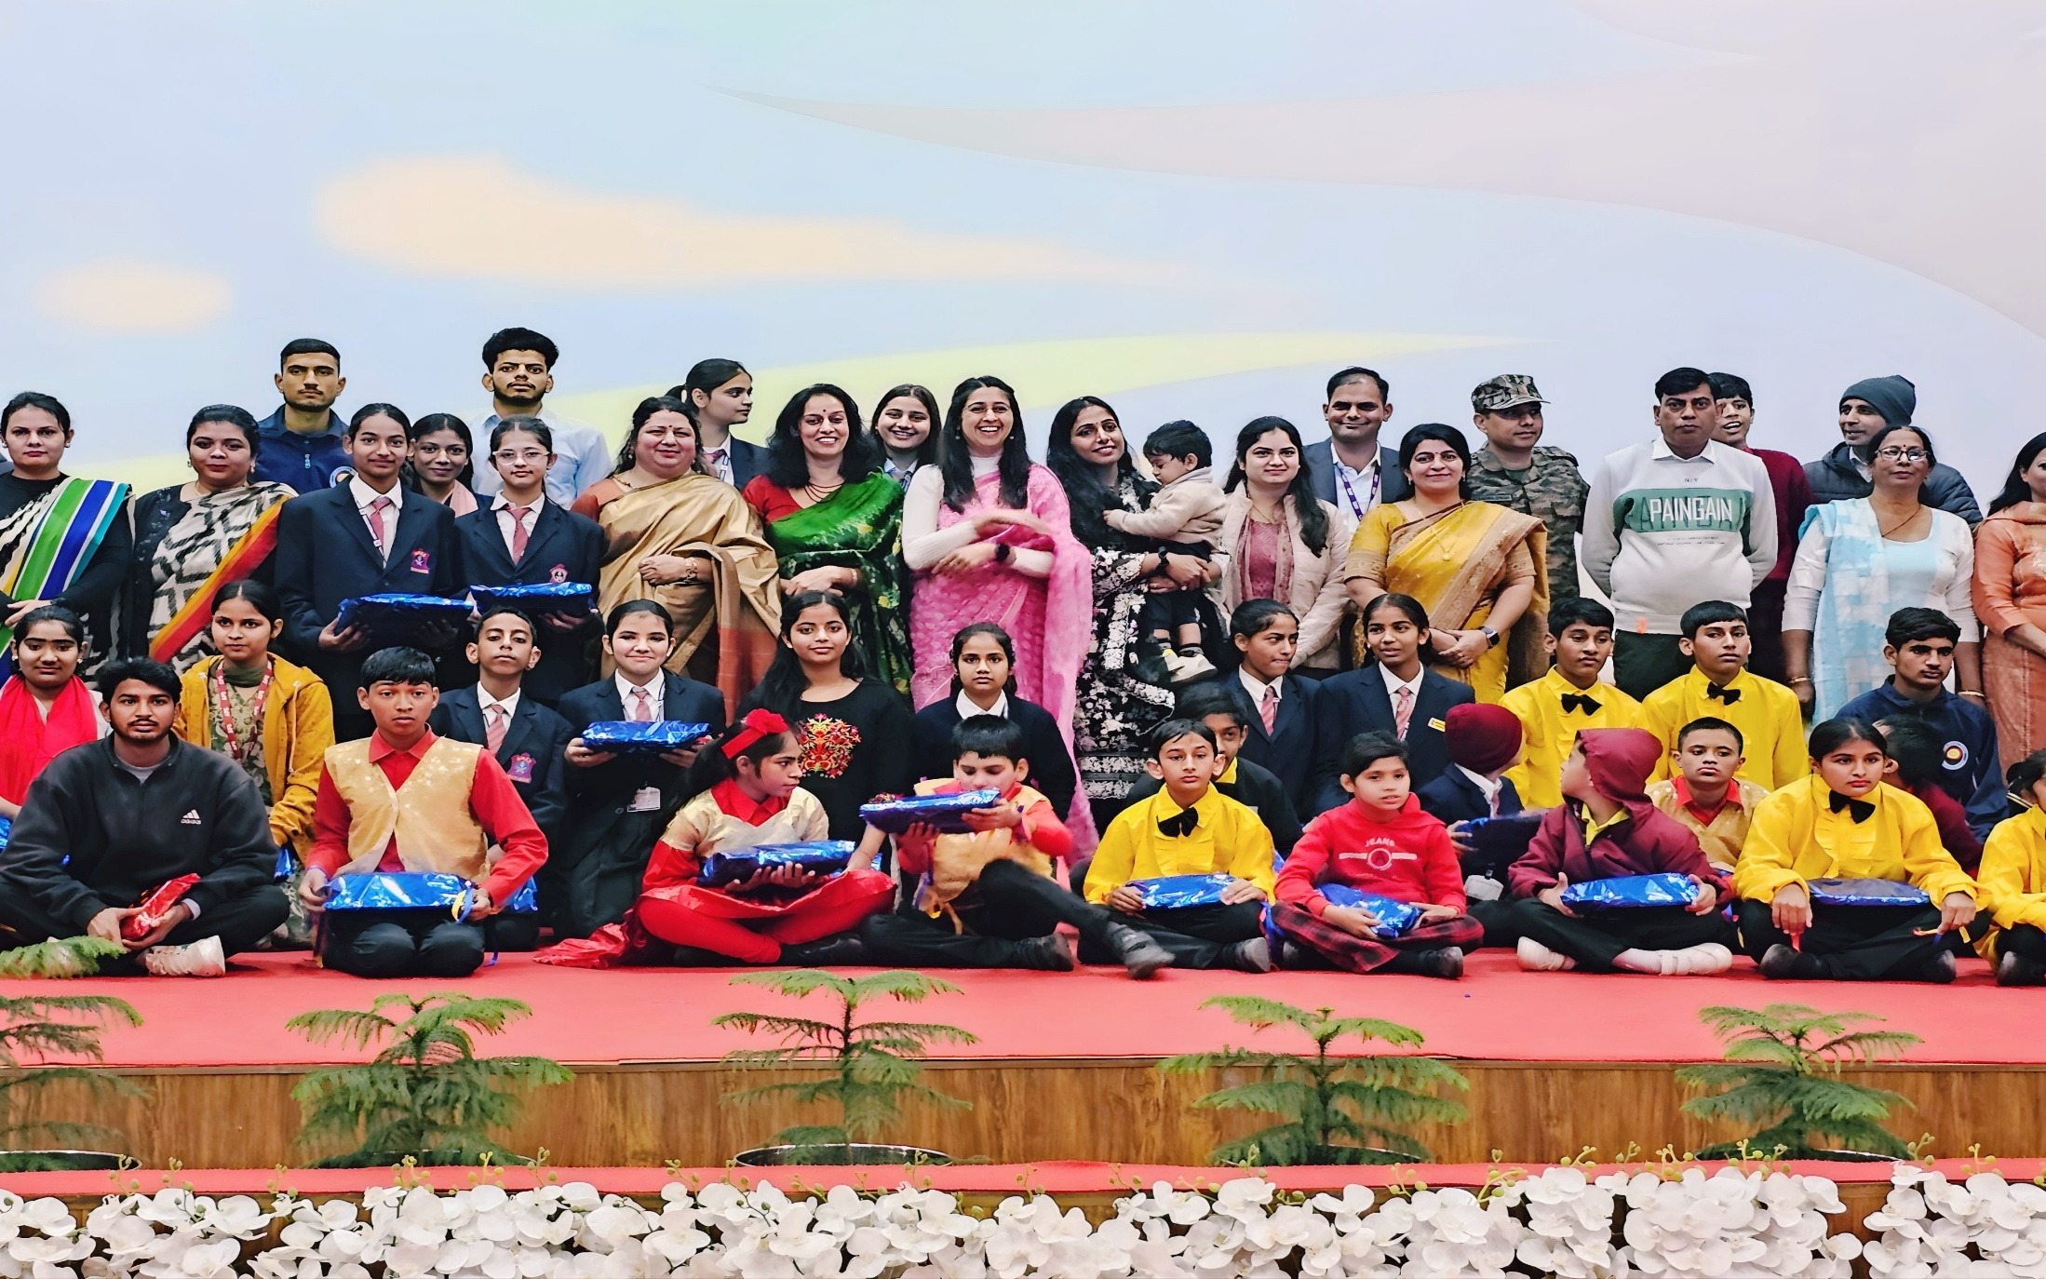
GROUP PHOTOGRAPH

Slide 10
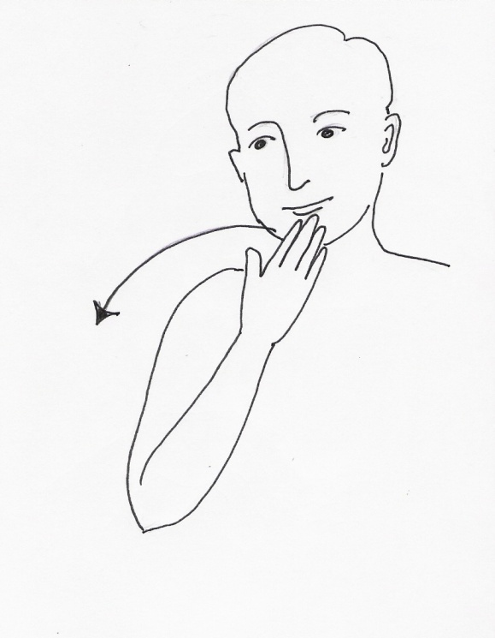



ARMY PUBLIC SCHOOL HISAR

